Slide 1


“Designing a Cloud Computing Architecture for small Business Organization”

Slide 2
CONTENT
Introduction
Problem Statement
Company’s Objective
Why Migrate to the Cloud
Cloud Service Model
Data Migration Consideration
High Availability Strategies
Security in the Cloud
Implementation Roadmap
Conclusion
Q&A
Acknowledgments

Slide 3
Cloud computing is the delivery of different services through the Internet. These resources include tools and applications like data storage, servers, databases, networking, and software.
Models
Service Models
Levels of Cloud Service
• Public cloud
• Private cloud
• Community cloud
• Hybrid cloud
• Software as a Service (SaaS)
• Platform as a Service (PaaS)
• Infrastructure as a Service (IaaS)
9. Application
8. Data
7. Runtime
6. Middleware
5.O/S
4. Virtualization
3. Servers
2. Storage
1. Network
PaaS
IaaS

Slide 4
Scenario: A retail company wants to modernize its IT infrastructure by moving to the cloud. They have an on-premises data center hosting their online store, inventory management system, and customer database.
My role: Cloud computing designing migration strategy.

Slide 5
Company's Objectives
Improve website performance
Enhance scalability during peak seasons
Cloud vendor and type of cloud
Cost Structures – On-premise vs Cloud vs Hybrid
Security and data protection
Backup and disaster recovery
Portability: Ability to migrate or switch service providers easily
Stay competitive and modernize IT infrastructure

Slide 6
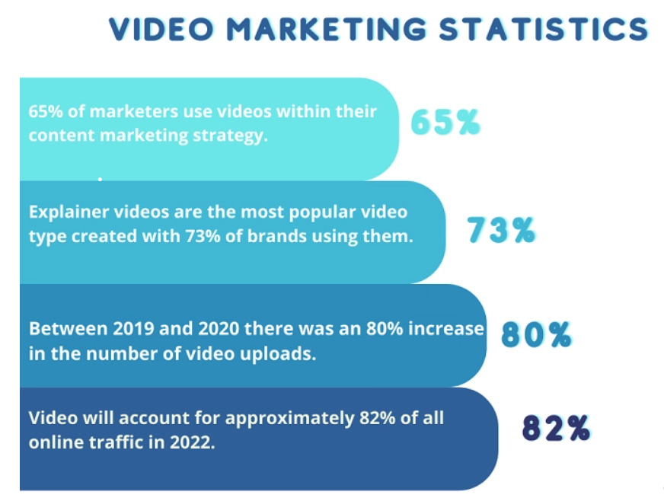
Why Migrate to the Cloud?
Improved Performance
Faster website, better user experience
Scalability
Flexible resource allocation based on demand
Cost Reduction
Elimination of on-premises hardware expenses
Enhanced Agility
Quick deployment of new features and updates

Slide 7
Cloud Service Model
Infrastructure as a Service (IaaS)
Platform as a Service (PaaS)
Provides virtualized computing resources.
You manage applications and configurations on the virtual machines.
Offers flexibility, control, and easy migration for existing workloads.
Suitable for scenarios needing custom software installations.
Offers a platform for developing, deploying, and managing applications.
Cloud provider manages hardware and operating systems.
Simplifies development, enables faster time-to-market, and reduces maintenance.
May have limitations on customization and can lead to vendor lock-in.
Choosing the Right Model:
For the retail company:
Migrate data center and existing systems to IaaS for control and flexibility.
Use PaaS for applications like inventory management for faster development.
Consider factors like existing technology, development needs, and IT expertise when making the decision. A combination of IaaS and PaaS can offer a balanced approach to meet the company's objectives.

Slide 8
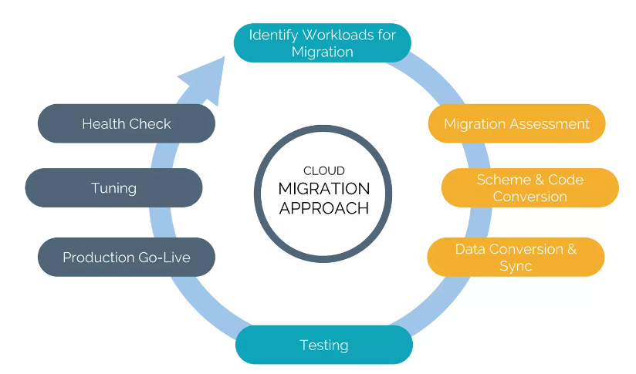
Data Migration Considerations
Data Security
Encryption during transit and at rest
Data Consistency
Ensuring accuracy and integrity
Bandwidth and Latency
Network performance impact
Downtime Minimization
Planning for minimal disruption

Slide 9
High Availability Strategies
Load Balancing
Distributing traffic for optimal performance
Multi-Region Deployment
Reducing impact of outages
Automated Scaling
Adjusting resources based on demand
Disaster Recovery Plan
Quick recovery from disruptions

Slide 10
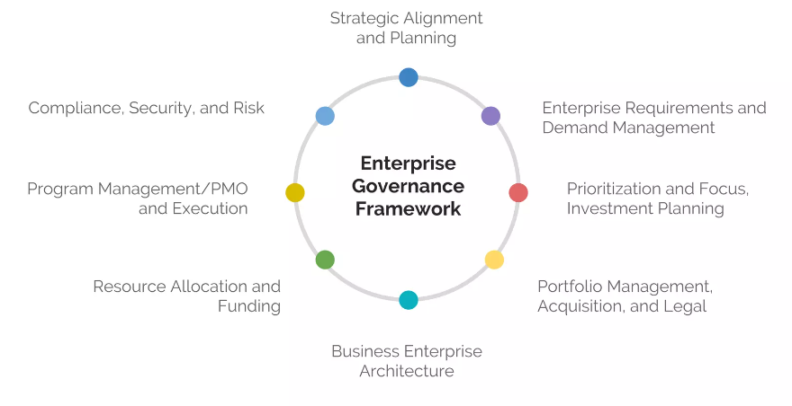
Security in the Cloud
Access Control
Multi-factor authentication, role-based access
Data Encryption
Protecting data from unauthorized access
Regular Auditing
Identifying vulnerabilities and compliance
Intrusion Detection
Monitoring and responding to breaches
Vendor Security
Understanding shared responsibility model

Slide 11
Implementation Roadmap
Assessment: Evaluate current setup, set migration goals.
Data Migration: Transfer data securely to the cloud.
Application Migration: Adapt and test applications for the cloud.
Testing: Thoroughly test systems and performance.
Deployment: Configure, deploy, and monitor in the cloud.
Monitoring & Optimization: Monitor, adjust, and optimize resources.
Training & Documentation: Train teams, create user guides.
Ongoing Management: Maintain, update, and enhance cloud environment.

Slide 12
Conclusion
In summary, our move towards a cloud computing architecture promises substantial benefits. Enhanced website performance, scalable operations, and reduced costs will redefine our retail business for the better. This migration requires meticulous planning and execution. However, the potential for increased customer satisfaction, resource efficiency, and agility is significant. Our commitment to security and monitoring will ensure the safety of our data and operations. With the outlined roadmap, our transition to the cloud is poised for success. By embracing modern cloud technologies, we're not just upgrading our IT; we're forging a path to an innovative and efficient future. Thank you for being part of this transformative journey. Together, we're shaping a future where excellence thrives in the cloud.
Thank you.

Slide 13
Q&A
Question 1: Which cloud service model is suitable for the retail company, and why?
Ans.:- For the retail company, a combination of Infrastructure as a Service (IaaS) and Platform as a Service (PaaS) models would be suitable:
IaaS: This model allows the company to migrate its existing infrastructure, including virtual machines, storage, and networking components, to the cloud. It provides flexibility and control over the environment while outsourcing the underlying hardware management.
PaaS: The company can utilize PaaS for its inventory management system and other applications, enabling developers to focus on coding and application logic without concerning themselves with underlying infrastructure management.
Question 2: What are the key considerations for data migration during the cloud transition?
Ans.:- Data migration is a critical aspect of the cloud transition. Key considerations include:
Data Security: Ensure that data is encrypted during transit and at rest to maintain confidentiality and integrity.
Data Consistency: Maintain data consistency during migration to prevent discrepancies or data loss.
Bandwidth and Latency: Assess the network bandwidth and latency to avoid performance issues during data transfer.
Downtime Minimization: Plan for minimal downtime during migration to avoid disruptions to the online store and customer experience.

Slide 14
Q&A
Question 4: How can the retail company ensure high availability for their online store in the cloud?
Ans.:- To ensure high availability, the company can:
Implement Load Balancing: Distribute traffic across multiple instances to prevent overload and improve responsiveness.
Multi-Region Deployment: Deploy resources across multiple regions to mitigate the impact of regional outages.
Automated Scaling: Set up auto-scaling to adjust resource capacity based on demand, ensuring consistent performance during traffic spikes.
Disaster Recovery Plan: Establish a comprehensive disaster recovery plan to quickly recover from any potential service disruptions.
Question 5: How will the retail company manage security in the cloud environment?
Ans.:- To manage security effectively:
Access Control: Implement strong access controls, multi-factor authentication (MFA), and role-based access to limit unauthorized access.
Data Encryption: Utilize encryption for data at rest and in transit to protect sensitive information.
Regular Auditing: Conduct regular security audits and assessments to identify vulnerabilities and ensure compliance with industry standards.
Intrusion Detection and Prevention: Deploy intrusion detection and prevention systems to monitor and respond to potential security breaches.
Vendor Security: Collaborate closely with the chosen cloud provider to understand their security measures and responsibilities under the shared responsibility model.

Slide 15
Acknowledgement
Name: - Pratik Raj
Roll no.:- 23
Section: - C-006
Regd. No.:- 2041018013
Teacher :- Sankar Mridha Sir and Jason Marandi Sir

